Slide 1
Assignment
Read some trending newspaper articles on the social media and the follow-up comments under them. Find at least FIVE fallacies in the articles (if any) and in the comments.
Link to submit:
https://forms.gle/bhwiVRNHszrpapsY9
Note: Delete lesson slides; only keep the assignment slides.

Slide 2


Assignment
Text 2:
Fallacy type: Equivocation
Source: https://twitter.com/language_nerds_/status/1593610008519970817/photo/1

Slide 3
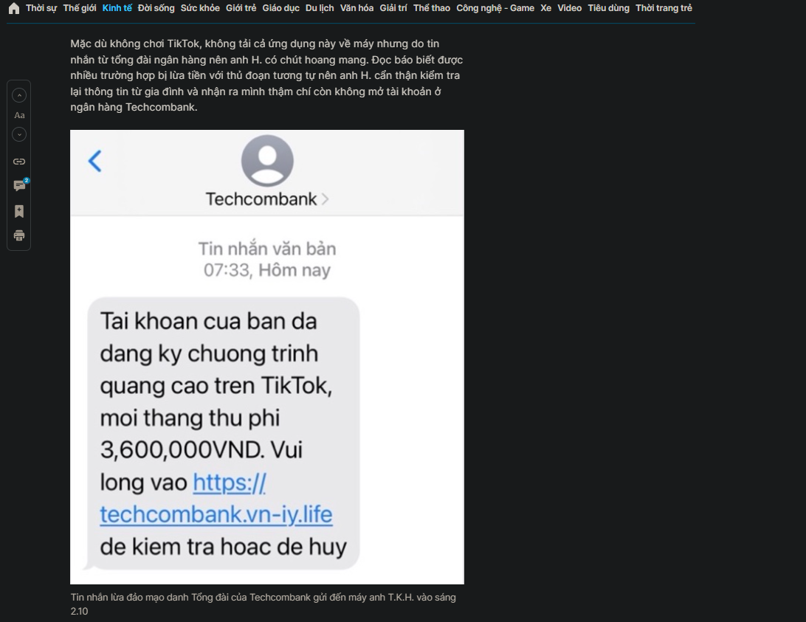
Assignment
Text 3:
Fallacy type: Scare tactic
Source: https://thanhnien.vn/lai-no-ro-lua-dao-qua-tin-nhan-dau-so-ngan-hang-cung-khong-tin-duoc-1851505987.htm

